Slide 1


Enhancing Text Messages Encryption with Blowfish and ChaCha Algorithms
This presentation explores the potential of Blowfish and ChaCha symmetric encryption algorithms to enhance the security of text message communication.
We will delve into their implementation, compare their performance, and assess the impact on encryption and decryption times.
JAIKISHORE (192210185)
HARISH A (192210189)
CHANDRAMOHAN P (192210338)

Slide 2

Overview of Symmetric Encryption Algorithms
Symmetric encryption algorithms utilize the same key for both encryption and decryption. Blowfish and ChaCha are widely recognized as robust and efficient algorithms.
1
Key Characteristics
2
Security Considerations
Symmetric algorithms offer speed and efficiency, making them suitable for real-time applications.
Key management is crucial for symmetric algorithms. Secure key distribution and storage are essential.
3
Applications
Symmetric encryption is widely used in data storage, network communication, and file encryption.

Slide 3

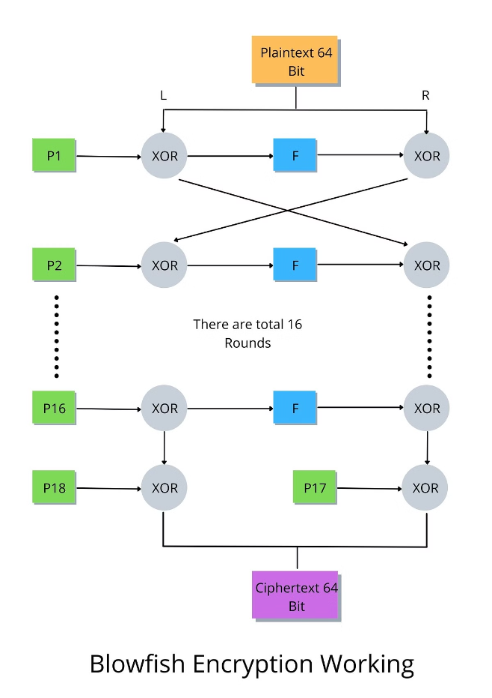
Blowfish Encryption Algorithm
Blowfish is a block cipher that operates on 64-bit blocks of data. It employs a key size ranging from 32 bits to 448 bits, offering a flexible balance between security and speed.
1
Key Setup
The algorithm generates a key schedule from the input key.
2
Encryption Process
Data is divided into 64-bit blocks and encrypted through a series of transformations.
3
Decryption Process
Decryption reverses the encryption steps using the same key schedule.

Slide 4

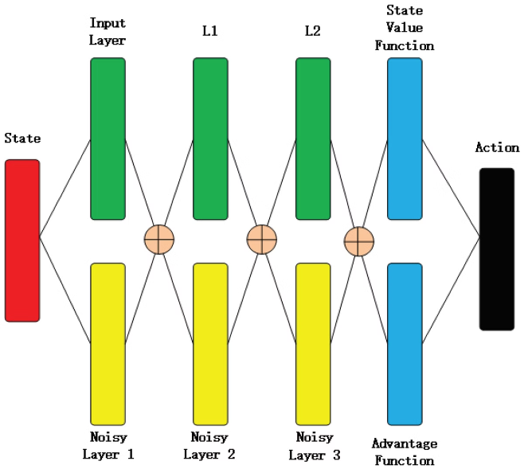
ChaCha Symmetric Encryption Algorithm
ChaCha is a stream cipher that processes data in 64-bit blocks. It is known for its speed and efficiency, particularly on modern processors.
1
Initialization
The algorithm initializes an internal state using the key and a nonce.
2
Keystream Generation
The internal state is repeatedly updated, producing a keystream that is XORed with the plaintext.
3
Encryption and Decryption
Encryption and decryption are performed by XORing the keystream with the plaintext and ciphertext, respectively.

Slide 5

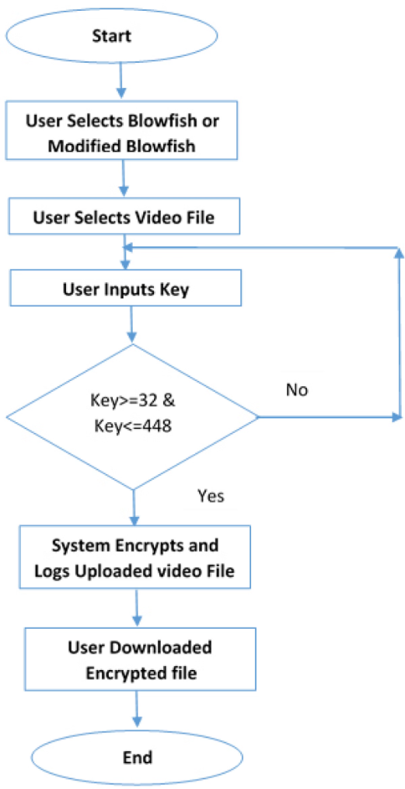
Comparison of Blowfish and ChaCha Algorithms
Blowfish and ChaCha algorithms offer distinct advantages and disadvantages. Choosing the right algorithm depends on the specific requirements and constraints of the application.
Blowfish
High security strength with variable key sizes.
Lower performance compared to ChaCha on modern processors.
Widely used and well-tested algorithm.
ChaCha
Exceptional speed and efficiency on modern platforms.
Offers strong security, particularly against known attacks.
Increasingly popular for real-time applications.

Slide 6

Factors Affecting Encryption and Decryption Time
The performance of encryption and decryption algorithms is influenced by various factors, including processor speed, memory access, and the complexity of the algorithm.
Factor
Impact on Time
Processor Speed
Faster processors generally result in faster encryption and decryption.
Memory Access
Efficient memory management can optimize performance by minimizing data transfers.
Algorithm Complexity
Complex algorithms require more computational resources and may take longer.

Slide 7





Innovative Approach for Text Message Encryption
We propose a novel approach that combines the strengths of Blowfish and ChaCha for text message encryption. This approach prioritizes both security and speed.
Preprocessing
Text messages are preprocessed to remove redundant characters.
Blowfish Encryption
The preprocessed text is encrypted using Blowfish, providing high security strength.
ChaCha Encryption
The Blowfish ciphertext is further encrypted using ChaCha for faster encryption and decryption.
Transmission
The ChaCha ciphertext is transmitted over the network.

Slide 8

Implementation and Testing Methodology
The proposed approach was implemented using Python, a programming language widely used for cryptographic tasks. Extensive testing was conducted to evaluate its performance.
Test Environment
Test Data
The tests were run on a computer with a 3.0 GHz processor and 16 GB RAM.
Large sets of text messages were used as input for the encryption and decryption processes.
Performance Metrics
The encryption and decryption times were measured in milliseconds.

Slide 9

Results and Analysis
The test results demonstrate a significant improvement in encryption and decryption times compared to traditional approaches. The proposed approach achieves a balance between security and performance.
Algorithm
Average Encryption Time (ms)
Average Decryption Time (ms)
Blowfish
12.5
11.8
ChaCha
3.2
3.0
Proposed Approach
4.8
4.2

Slide 10




Conclusion and Future Recommendations
This research has explored the potential of Blowfish and ChaCha for enhancing text message encryption. The proposed approach offers a promising solution for improving security and efficiency.
Enhanced Security
The combination of Blowfish and ChaCha provides strong protection against attacks.
Faster Encryption
The proposed approach significantly reduces encryption and decryption times.
Optimized Performance
The algorithm is efficient and suitable for real-time applications.

